Slide 1
SIES GRADUATE SCHOOL OF TECHNOLOGY
DEPARTMENT OF ARTIFICIAL INTELLIGENCE AND DATA SCIENCE
BE VII Semester
Mini Project Seminar
“Drug Interaction and Adverse-Effect Predictor”
Presented By:
Aditya Koparkar, Omer Ovias, Khalid Jalal & Adil Arkate
Under the guidance of Prof. Gayatri Satpute

Slide 2

CONTENTS
1. INTRODUCTION
2. METHODOLOGY
3. IMPLEMENTATION
4. RESULTS
5. CONCLUSION
6. REFERENCES

Slide 3

1. INTRODUCTION
THE CHALLENGE
PROJECT OBJECTIVES
Medication combinations can create interactions or change adverse-effect risk. Manually cross-checking fragmented sources is slow, and missing database records do not prove safety.
• Merge public biomedical data
• Predict interaction probability, type and side effects
• Rank concerns and show supporting paths
• Provide an inspectable web interface
1,706
526,105
7,456
915
Drug nodes in the drug universe
Unique known interaction pairs
Knowledge-graph nodes
Side-effect labels retained
Intended use: research and educational decision support only — not a medical device.
3

Slide 4
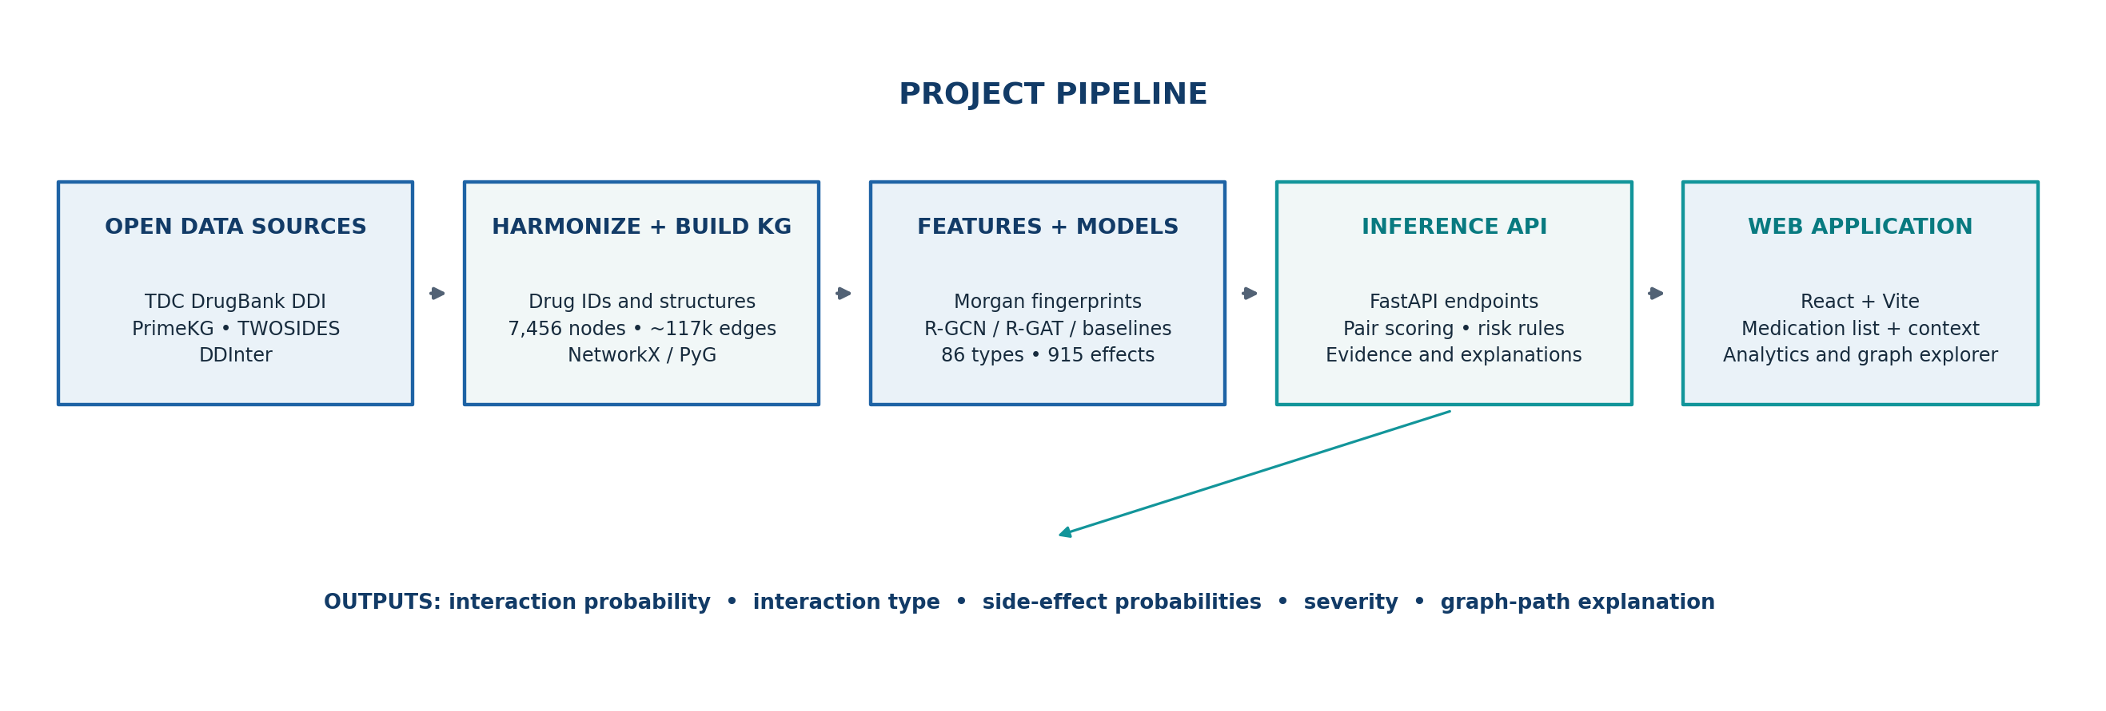
2. METHODOLOGY: END-TO-END PIPELINE
Key design decision: interaction labels are kept separate from graph relations to reduce label leakage into message passing.
4

Slide 5
2. METHODOLOGY: MODEL DESIGN
FINGERPRINT BASELINES
GRAPH MODELS
THREE PREDICTION HEADS
Morgan fingerprints
1,024 bits per drug
Logistic regression (SGD)
XGBoost
R-GCN: relational message passing
R-GAT: attention over relations
R-GCN + GIN: molecular graph encoder (not served)
1. Interaction probability
2. One of 86 interaction types
3. Multi-label probabilities for 915 side effects
EVALUATION SPLITS
LABEL HANDLING
• Random split: interacting pairs divided 80/10/10.
• Cold-start: test pairs include at least one drug unseen in training.
• Unrecorded pairs are unlabelled, not safe negatives.
• Metrics also use degree-matched unlabelled pairs as a harder set.
5

Slide 6
3. IMPLEMENTATION: APPLICATION WORKFLOW
1
ENTER
2
ANALYSE
3
REVIEW
4
EXPLAIN
Search and select 2–20 medications; optional prescription text extraction.
Score all drug pairs and apply severity and patient-context rules.
See regimen risk, flagged pairs, effects, evidence and severity source.
Open the pair path, model-attribution view, evidence and drug cards.
Other modules: patient-context alerts • knowledge-graph explorer • model analytics • RxNorm normalization • FAERS evidence • safer-alternative suggestions • audit log
Backend: FastAPI | Frontend: React + Vite | Graph/model layer: PyTorch Geometric + NetworkX
6

Slide 7
4. RESULTS: EVALUATION DESIGN
DATA SCALE
METRICS
ROBUSTNESS CHECK
1,706 drugs
1,454,365 possible pairs
526,105 unique known pairs
~117k biomedical graph edges
AUROC and AUPRC
F1 with threshold tuned on validation
Hits@20 / Hits@50 / Hits@100
Auxiliary type and side-effect scores
Random split is easier and may be optimistic.
Cold-start tests drugs held out from training.
Degree-matched unlabelled pairs add difficulty.
Evaluation uses unlabelled pairs as comparison examples — they may include interactions absent from the source databases.
• Therefore, metrics are lower-bound-style measures of ranking against recorded labels, not estimates of clinical safety.
• The model card explicitly states that the system has no prospective clinical validation.
7

Slide 8
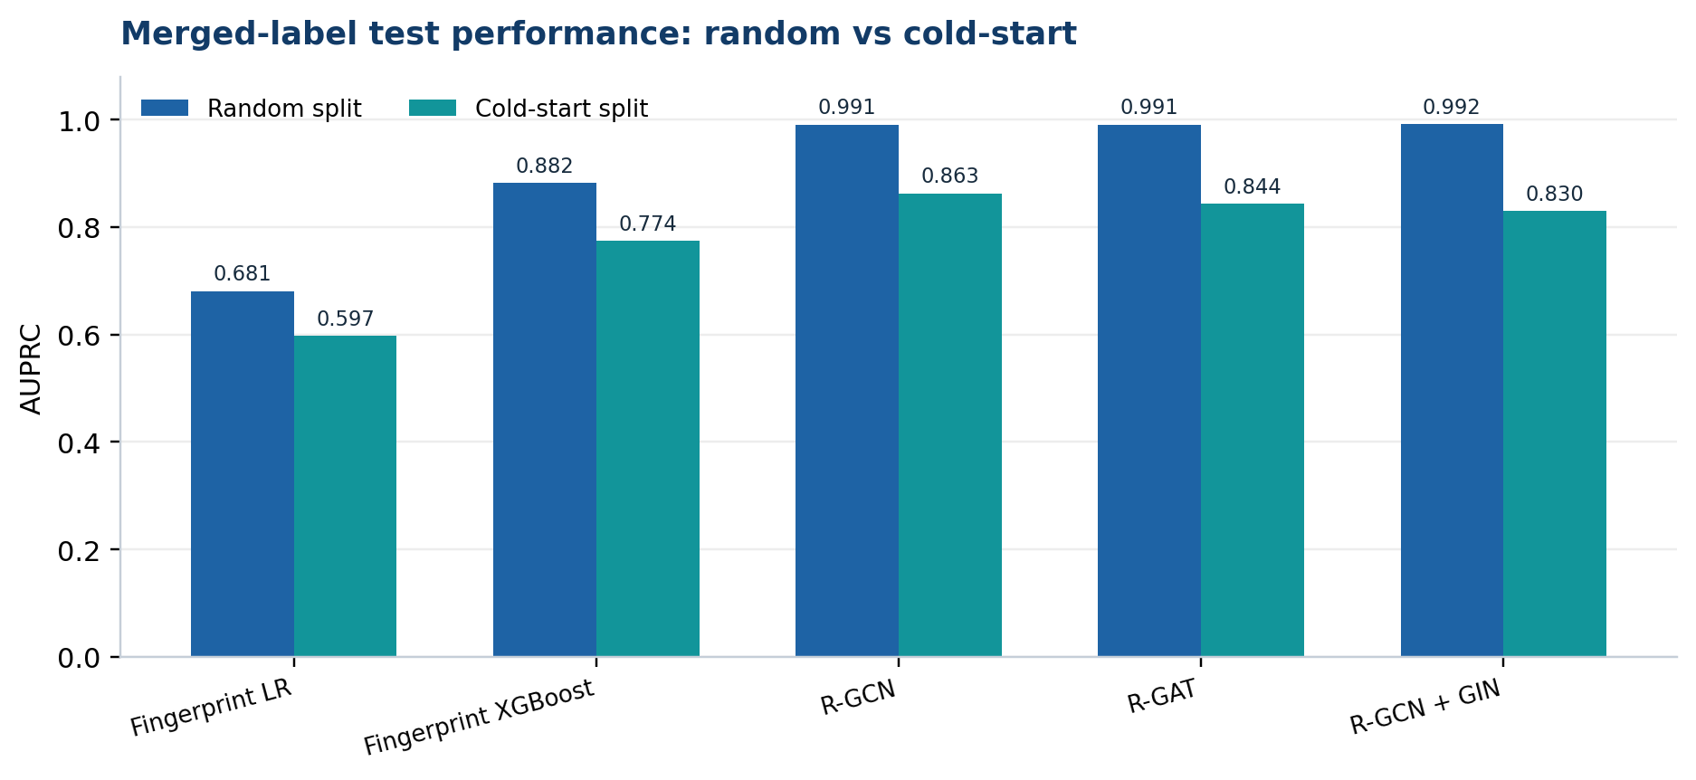
4. RESULTS: INTERACTION PREDICTION
BEST SERVED MODEL
R-GCN
Cold-start AUROC 0.870
Cold-start AUPRC 0.863
WHY COLD-START?
Includes drug pairs with at least one drug not seen during training.
Random-split R-GCN: AUROC 0.992 / AUPRC 0.991 • Degree-matched cold-start: AUROC 0.843 / AUPRC 0.837
8

Slide 9
4. RESULTS: EXPLAINABILITY AND LIMITATIONS
ILLUSTRATIVE CASE STUDY
EXPLANATION AGREEMENT
Warfarin + Ibuprofen
Model score: 0.76
Top model-attribution neighbour: CYP2C9
Highest ranked path node: gastrointestinal hemorrhage
In 10 curated pairs, the model’s top neighbour was on a KG path in 80%.
Across 200 test pairs, the top-5 overlap was 11%; explanations are complementary, not identical.
IMPORTANT LIMITATIONS
• No prospective clinical validation; statistical predictions can be incomplete or wrong.
• No flag does not establish safety. Confirm with an authoritative drug reference and healthcare professional.
• Severity for pairs without DDInter annotation is a project type-based estimate; evidence sources may be biased or stale.
9

Slide 10
5. CONCLUSION AND FUTURE WORK
CONCLUSION
FUTURE WORK
The project integrates public biomedical data, a knowledge graph, relational GNN predictions, interaction severity, side-effect estimates and explanation paths in a single web application. The R-GCN is the strongest served model among the evaluated options for cold-start interaction ranking.
Temporal and external validation; better-calibrated and less imbalanced side-effect prediction; expanded drug coverage; clinician review of explanations; clearer evidence freshness and uncertainty indicators.
Takeaway: a promising research prototype for review and exploration — not a stand-alone prescribing or medication-safety authority.
10

Slide 11
6. REFERENCES
• [1] Submitted project package: README.md, USER_GUIDE.md, MODEL_CARD.md and reports/metrics.json.
• [2] TDC DrugBank DDI benchmark / DeepDDI subset — interaction labels and drug structures.
• [3] PrimeKG — biomedical knowledge graph and linked drug, protein, disease and side-effect relations.
• [4] Tatonetti et al. Data-driven prediction of drug effects and interactions. Science Translational Medicine, 2012.
• [5] DDInter — curated drug-drug interaction severity annotations.
• [6] Schlichtkrull et al. Modeling Relational Data with Graph Convolutional Networks. ESWC, 2018.
• [7] Veličković et al. Graph Attention Networks. ICLR, 2018.
• [8] Ying et al. GNNExplainer: Generating Explanations for Graph Neural Networks. NeurIPS, 2019.
• [9] PyTorch Geometric documentation: https://pytorch-geometric.readthedocs.io/.
Thank you
11

